Slide 1
SESG – GIT asdfasdfasdf
Andy Kelsey

Slide 2

What is Git?
Open source distributed revision control system
Created by Linus Torvalds and other Linux kernel developers
Launched in 2005 under GPLv2 license
Replaced BitKeeper as SCM system for the Linux kernel

Slide 3
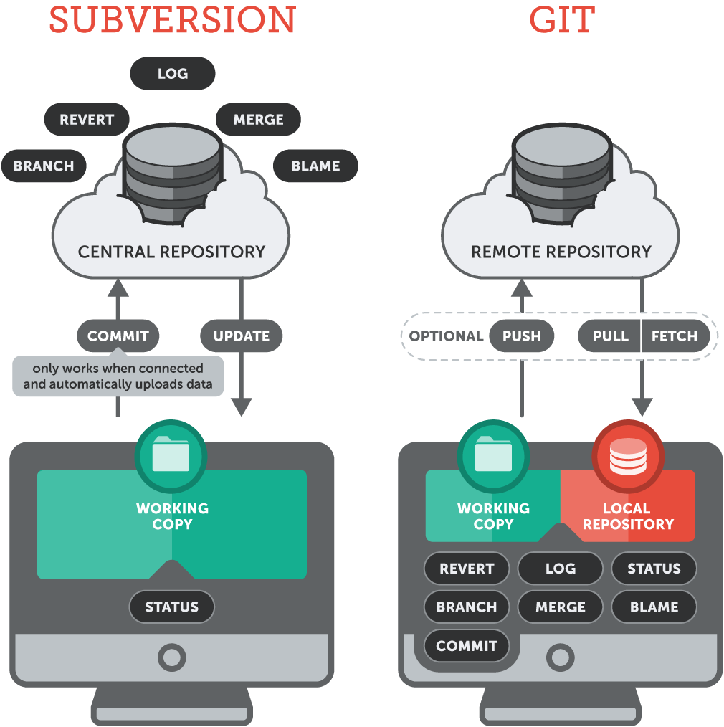
Centralized vs Distributed

Slide 4
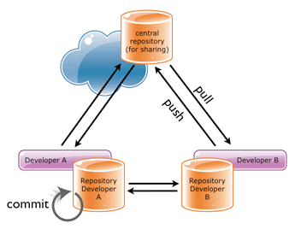
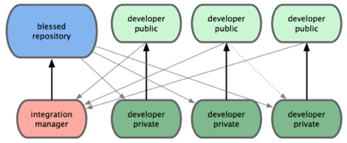
Why use Distributed?
Each developer has their own local repository
This is separate from their “working copy”
Allows commits off-line
Can be configured to use a remote “SVN style” repository
Speed increase for commits, logs, diffs, update, blame
Complete local back-up
hard to lose data
Can use different workflows
E.g. integrator approach

Slide 5
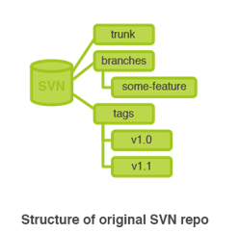
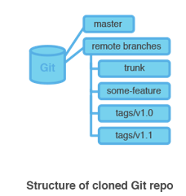
Repository Structure
SVN
trunk
branches
A copy of the project in another folder
tags
URLs are used to point to all locations.
Git
Consist of a single “.git” folder
Located in root of a project
Branches/tags are addressed via commands
A pointer to a certain revision
URL only points to the location of the repository

Slide 6
Committing
SVN
Can only commit when connected to central repository
Commit gets instantly transferred to central repository
Commit gets assigned an ascending revision number
Git
Can commit to local repository whenever
Use “push” command to send commit to another repository
Commit gets assigned a SHA-1 id
Used for data integrity
Commit id will change if the commit or history changes
Unique “staging area” which allows part of files to be committed

Slide 7
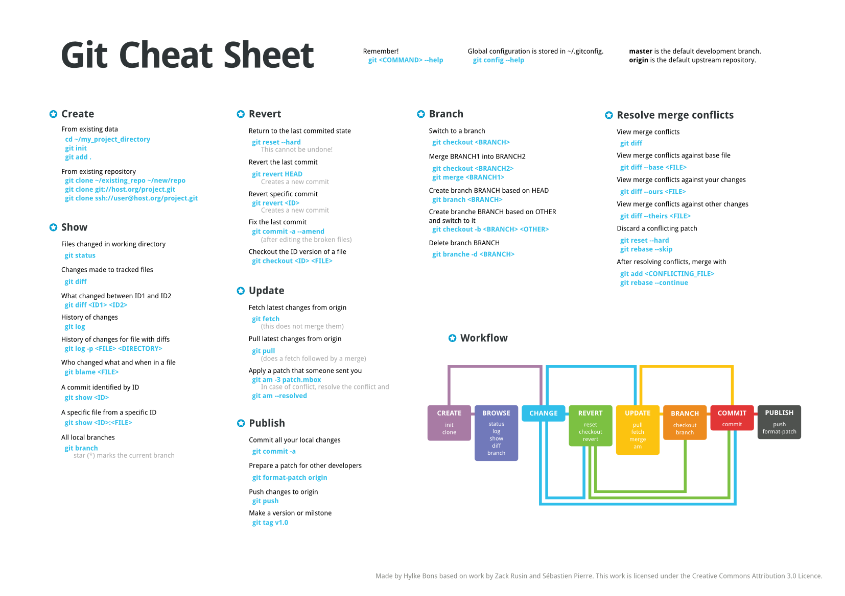
Commands

Slide 8
Pros and Cons
PROS | CONS
Speed increase for commits, diff, log, update, blame, branch, revert | Speed decrease for clone (SVN checkout)
Less hard disk usage – (E.g. Mozilla project 30x smaller using git) | Less UI available. TortoiseGit was recently released as a port of TortoiseSVN.
Data assurance with SHA-1 ids assigned to each commit | More complexity and higher learning curve
Branching and merging can done locally | Commit ids are not in sequential order
Local repository – Distributed
Multiple back-ups

Slide 9
DEMO TIME!

